Slide 1
Pokémon Battle Simulator
Using Streamlit Python and PokéAPI
Ishit Singh
Pratyush Pandey
Puru Singh

Slide 2
Languages and Libraries used:
Python Programming Language
Streamlit Library
Pandas Library
Matplotlib Library

Slide 3
Methodology:
Input Player names from user.
Select Pokémon per user from a dropdown menu.
Retrieve Pokémon information from Pokéapi.
Compare the stats of the Pokémons.
Conclude the winner from the comparison.
Draw the graph demonstration the comparison in Pokémons.

Slide 4
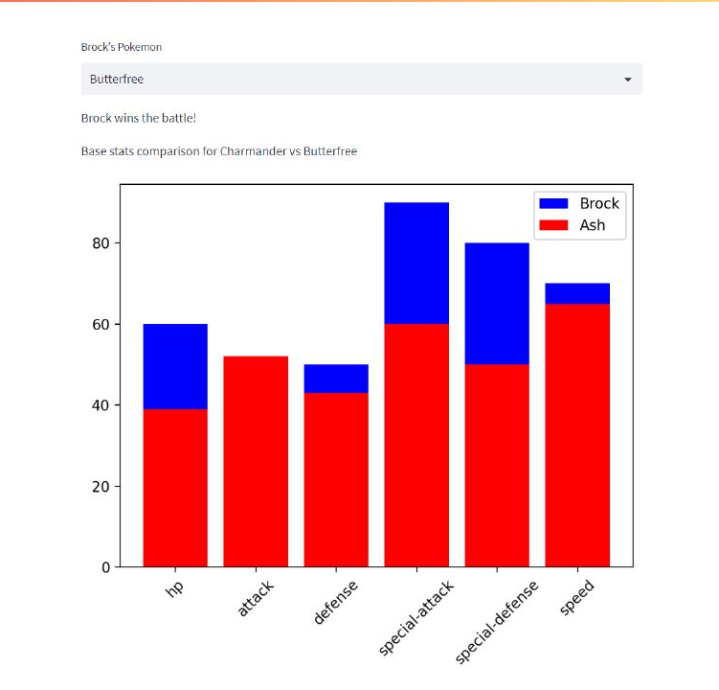
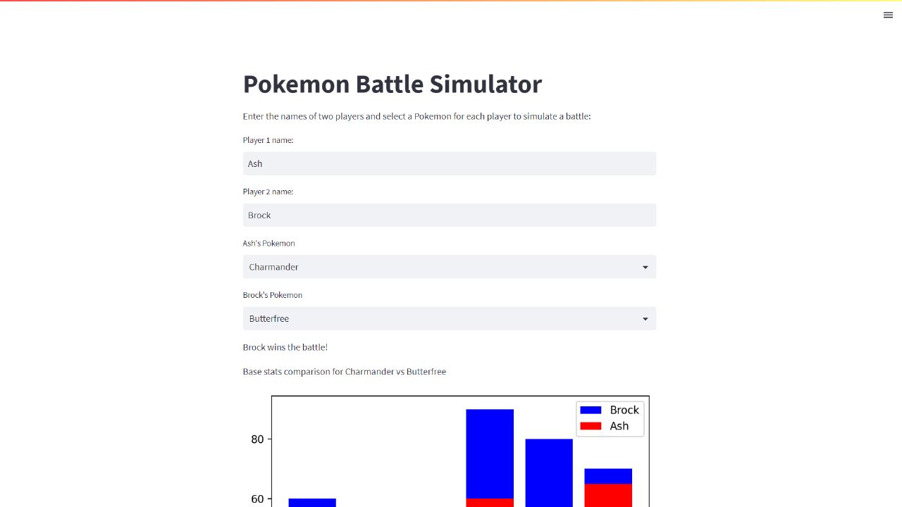
Sample Outputs:

Slide 5
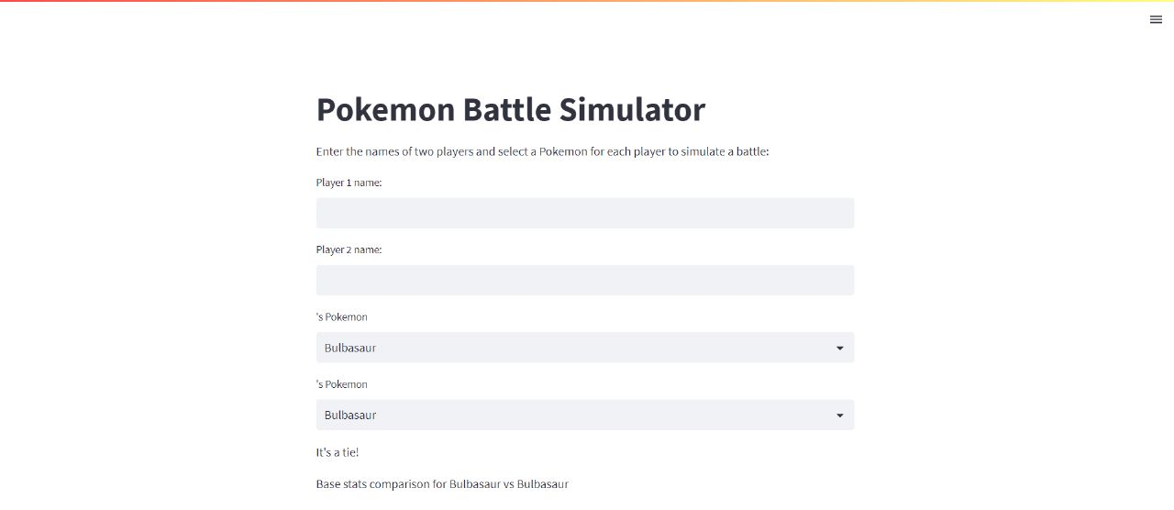
Sample output:

Slide 6
Conclusion:
Brock wins the Pokémon battle!

Slide 7
Thank you!
Presentation by:
Ishit Singh
Pratyush Pandey
Puru Singh

